Slide 1

Reporting and Analyzing Equity
11
Chapter
UAA – ACCT 201 Principles of Financial Accounting Dr. Fred Barbee

Slide 2

IS FUN!
ACCT 201
Chapter 11
Day Two

Slide 3
Chapter 11 - Day 2 - Agenda
Topic | LO | Read | HW
Treasury Stock | P5 | 483-485 | QS6, E9
Reporting Income Information | C4, A1 | 486-491 | E10, E13, E14
Retained Earnings | C5 | 491-492 | E12
Decision Analysis | A2, A3, A4 | 493-495 | E15, E16, E17
HW #10: P11-1A Due Today

Slide 4
Treasury Stock
11
Chapter

Slide 5

Treasury Stock
Corporations acquire shares of their own stock.
Why would a
company do
that?
Use the shares to acquire
control of another corporation.
To avoid a hostile takeover.
Use the shares for
employee stock options.
ACCT 201 ACCT 201 ACCT 201

Slide 6
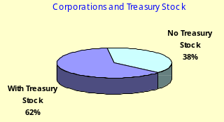
Treasury Stock
ACCT 201 ACCT 201 ACCT 201

Slide 7
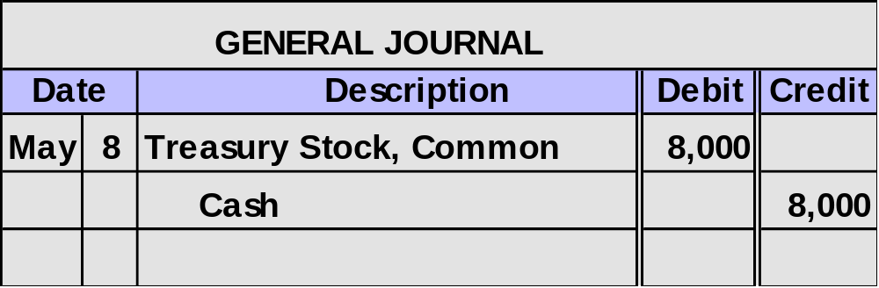
Purchasing Treasury Stock
On May, 8, 2002, Whitt, Inc. purchased 2,000 of its own shares of stock in the open market for $8,000.
Treasury stock is shown as a reduction in total
stockholders’ equity on the balance sheet.
ACCT 201 ACCT 201 ACCT 201

Slide 8
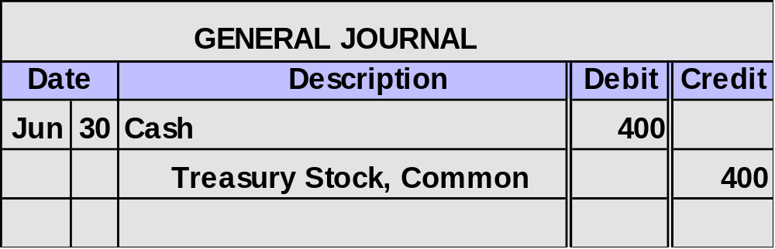
Selling Treasury Stock at Cost
On June 30, 2002, Whitt sold 100 shares of its treasury stock for $4 per share.
$8,000 ÷ 2,000 shares = $4 cost per treasury share
ACCT 201 ACCT 201 ACCT 201

Slide 9
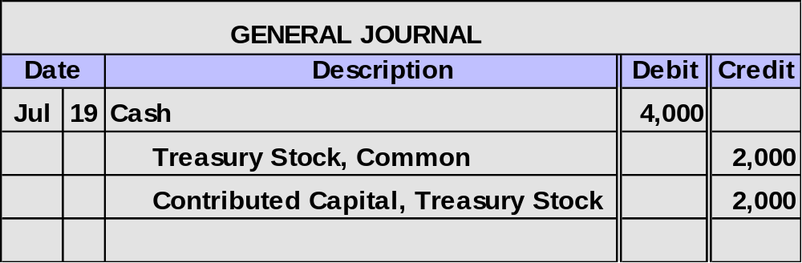

Selling Treasury Stock Above Cost
On July 19, 2002, Whitt, Inc. sold an additional 500 shares of its treasury stock for $8 per share.

Slide 10
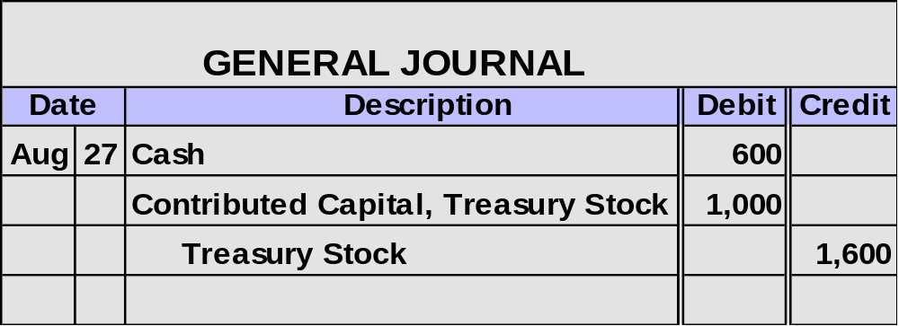

Selling Treasury Stock Below Cost
On August 27, 2002, Whitt sold an additional 400 shares of its treasury stock for $1.50 per share.

Slide 11
Reporting Income Information
11
Chapter

Slide 12
Reporting Income Information
Discontinued
Segments
Continuing
Operations
Extraordinary
Items
Change in
Accounting
Principle
Net Income
ACCT 201 ACCT 201 ACCT 201

Slide 13
Reporting Income Information
Revenues, expenses
and income generated
by the company’s
continuing operations.
Continuing
Operations
Net Income
ACCT 201 ACCT 201 ACCT 201

Slide 14
Reporting Income Information
Discontinued
Segments
Income from
operating the
discontinued segment
prior to its disposal
and gain or loss on the sale of the net
assets of the segment.
Net Income
ACCT 201 ACCT 201 ACCT 201

Slide 15
Reporting Income Information
A gain or loss that
is unusual in nature
and infrequent in
occurrence.
Extraordinary
Items
Net Income
ACCT 201 ACCT 201 ACCT 201

Slide 16
Reporting Income Information
The increase or decrease in income when changing from
one generally accepted
accounting principle to another.
Net Income
Change in
Accounting
Principle
ACCT 201 ACCT 201 ACCT 201

Slide 17
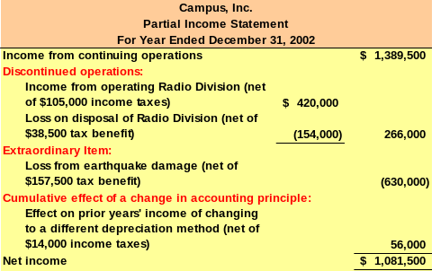
Reporting Income Information
ACCT 201 ACCT 201 ACCT 201

Slide 18
Changes in Accounting Principle
11
Chapter

Slide 19
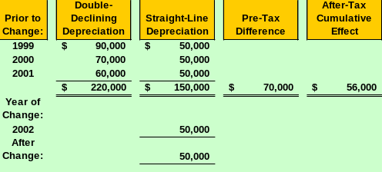
Changes in Accounting Principles
Campus, Inc. prepared the following schedule in connection with its change from double-declining balance to straight-line depreciation.
Campus is subject to
a 20% income tax rate

Slide 20
Earnings Per Share
11
Chapter

Slide 21
Earnings Per Share
Earnings per share is one of the most widely cited items of accounting information.
Basic
earnings
per share
Net income - Preferred dividends
Weighted-average common shares outstanding
=
ACCT 201 ACCT 201 ACCT 201

Slide 22
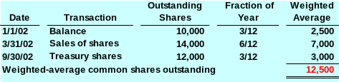
Changes in Shares Outstanding
Derby, Inc. reports net income of $75,000 and paid preferred dividends of $10,000 during 2002. The company started the year with 10,000 shares of common stock outstanding. Derby sold an additional 4,000 share of stock on March 31, and purchased 2,000 treasury shares on September 30, 2002.

Slide 23
Changes in Shares Outstanding
Derby, Inc. reports net income of $75,000 and paid preferred dividends of $10,000 during 2002. The company started the year with 10,000 shares of common stock outstanding. Derby sold an additional 4,000 share of stock on March 31, and purchased 2,000 treasury shares on September 30, 2002.
$75,000 - $10,000
12,500
EPS =
= $5.20

Slide 24
Complex Capital Structure
11
Chapter

Slide 25

Complex Capital Structure
Capital structure includes dilutive securities such as:
  Stock options (rights to purchase common stock).
  Preferred stock convertible into common stock.
These items may reduce the basic earnings per share.

Slide 26

Complex Capital Structure
The company may be required to report basic and diluted earnings per share on the face of the income statement.

Slide 27
Stock Options
11
Chapter

Slide 28

Stock Options
The right to purchase common stock at a fixed price over a specified period of time. As the stock’s price rises above the fixed option price, the value of the option increases.
Market
price of
stock $75
per share.
Option
purchase
price $30
per share.
ACCT 201 ACCT 201 ACCT 201

Slide 29

Stock Options
Options are given to key employees to motivate them to:
  focus on company performance,
  take a long-run perspective, and
  remain with the company.

Slide 30
Retained Earnings
11
Chapter

Slide 31
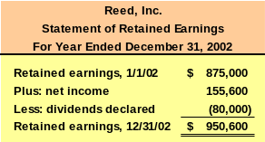
Retained Earnings
Total cumulative amount of reported net income less any net losses and dividends declared since the company started operating.
ACCT 201 ACCT 201 ACCT 201

Slide 32
Restricted Retained Earnings
Legal
Contractual
Most states restrict
the amount of
treasury stock
purchases to the
amount of retained
earnings.
Loan agreements
can include
restrictions on paying
dividends below a
certain amount of
retained earnings.
ACCT 201 ACCT 201 ACCT 201

Slide 33
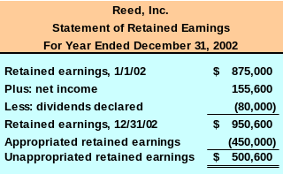
Appropriated Retained Earnings
A corporation’s directors can voluntarily limit dividends because of a special need for cash such as the purchase of new facilities.
ACCT 201 ACCT 201 ACCT 201

Slide 34
Prior Period Adjustments
11
Chapter

Slide 35
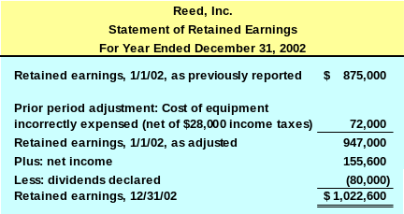
Prior Period Adjustments
Correction of material errors in past years’ financial statements.

Slide 36
Changes in Accounting Estimates
11
Chapter

Slide 37
Changes in Accounting Estimates
Many items reported in the financial statements are based on estimates.
If new information comes to light that would cause us to change our estimate, we show the impact of the change in current and future periods.

Slide 38
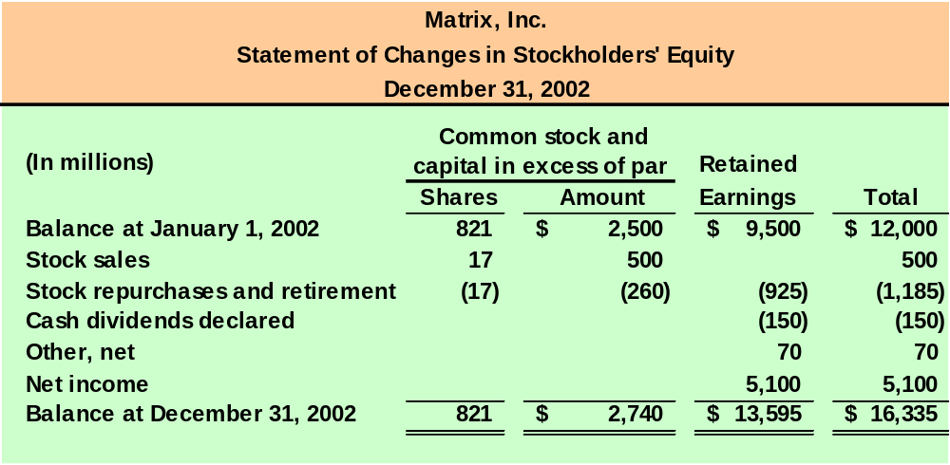
Statement of Changes in Stockholders’ Equity

Slide 39
Decision Analysis
11
Chapter

Slide 40
Dividend Yield
Annual amount of cash dividends distributed to common stockholders relative to the stock’s market price.
Dividend
Yield
Annual cash dividends per share
Market value per share
=

Slide 41
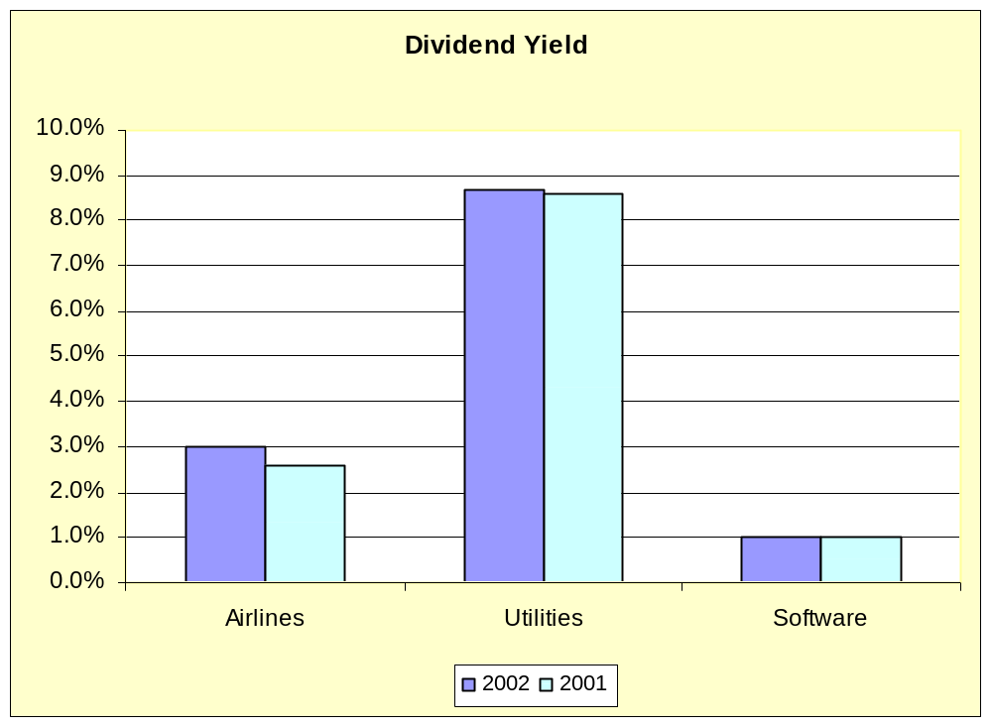
Dividend Yield

Slide 42
Price Earnings
This ratio reveals information about the stock market’s expectations for a company’s future growth in earnings, dividends, and opportunities.
Price-
Earnings
Market value per share
Earnings per share
=

